Slide 1



MICROSERVICES LOG ANALYSIS & MONITORING
Group 6
Dax
Khantil
Riken
Notes:
Introduction

Slide 2
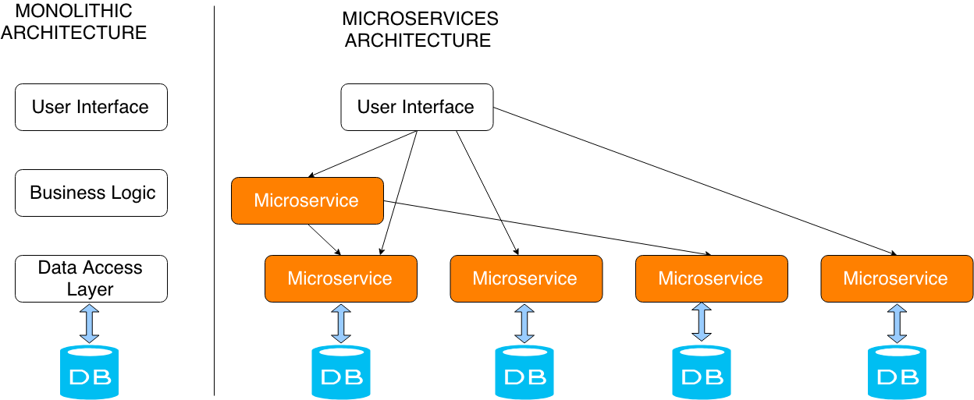
INTRODUCTION
Why Microservices?
Monolithic Architecture
No single failure module
Decouples Back-End Servers
Notes:
monolothic → microservice
loosly decopuled servers

Slide 3
INTRODUCTION
Why Real-Time Log Analysis?
Rapid detection of failed processes
Helps in determining trends
Easy troubleshooting & monitoring
Improve Performance

Slide 4
INTRODUCTION
Why Data Intensive Computing?
Large number of Microservices
Varying ingestion rates
Single aggregated view
VOLUME, VELOCITY, VARIETY
Notes:
Justify, microservices and volume

Slide 5
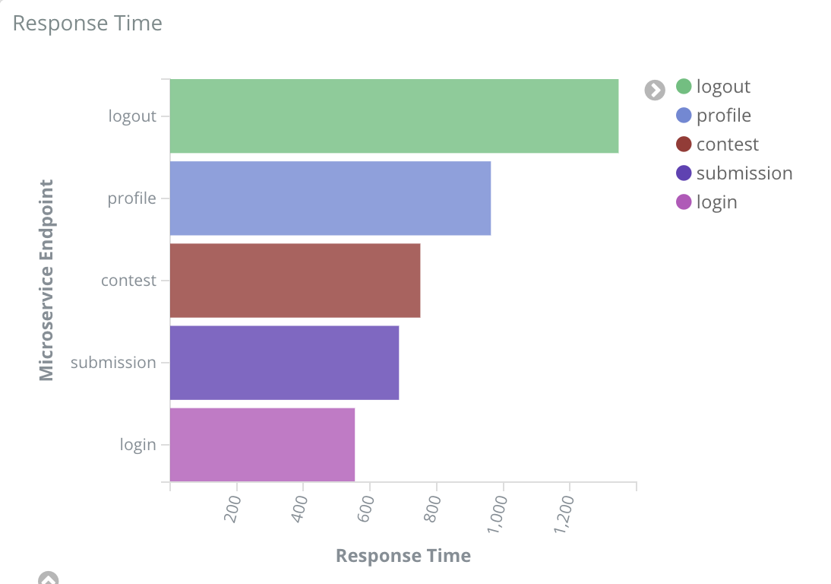
OVERVIEW
Micro-
services
Data Processing
Analyse Charts
Data
Response Time (ms), Response Code (2XX, 4XX)
Endpoints (Login, Home, Profile, Logout)
IP, TimeStamp
Notes:
Input data and flow

Slide 6
INPUT
Semi-Synthetic Log Producers
Totally Configurable
Endpoints
Speed of log generation (ms)
Endpoints versus Response Time
Endpoints versus Response Code
Notes:
Conf file, based on what

Slide 7
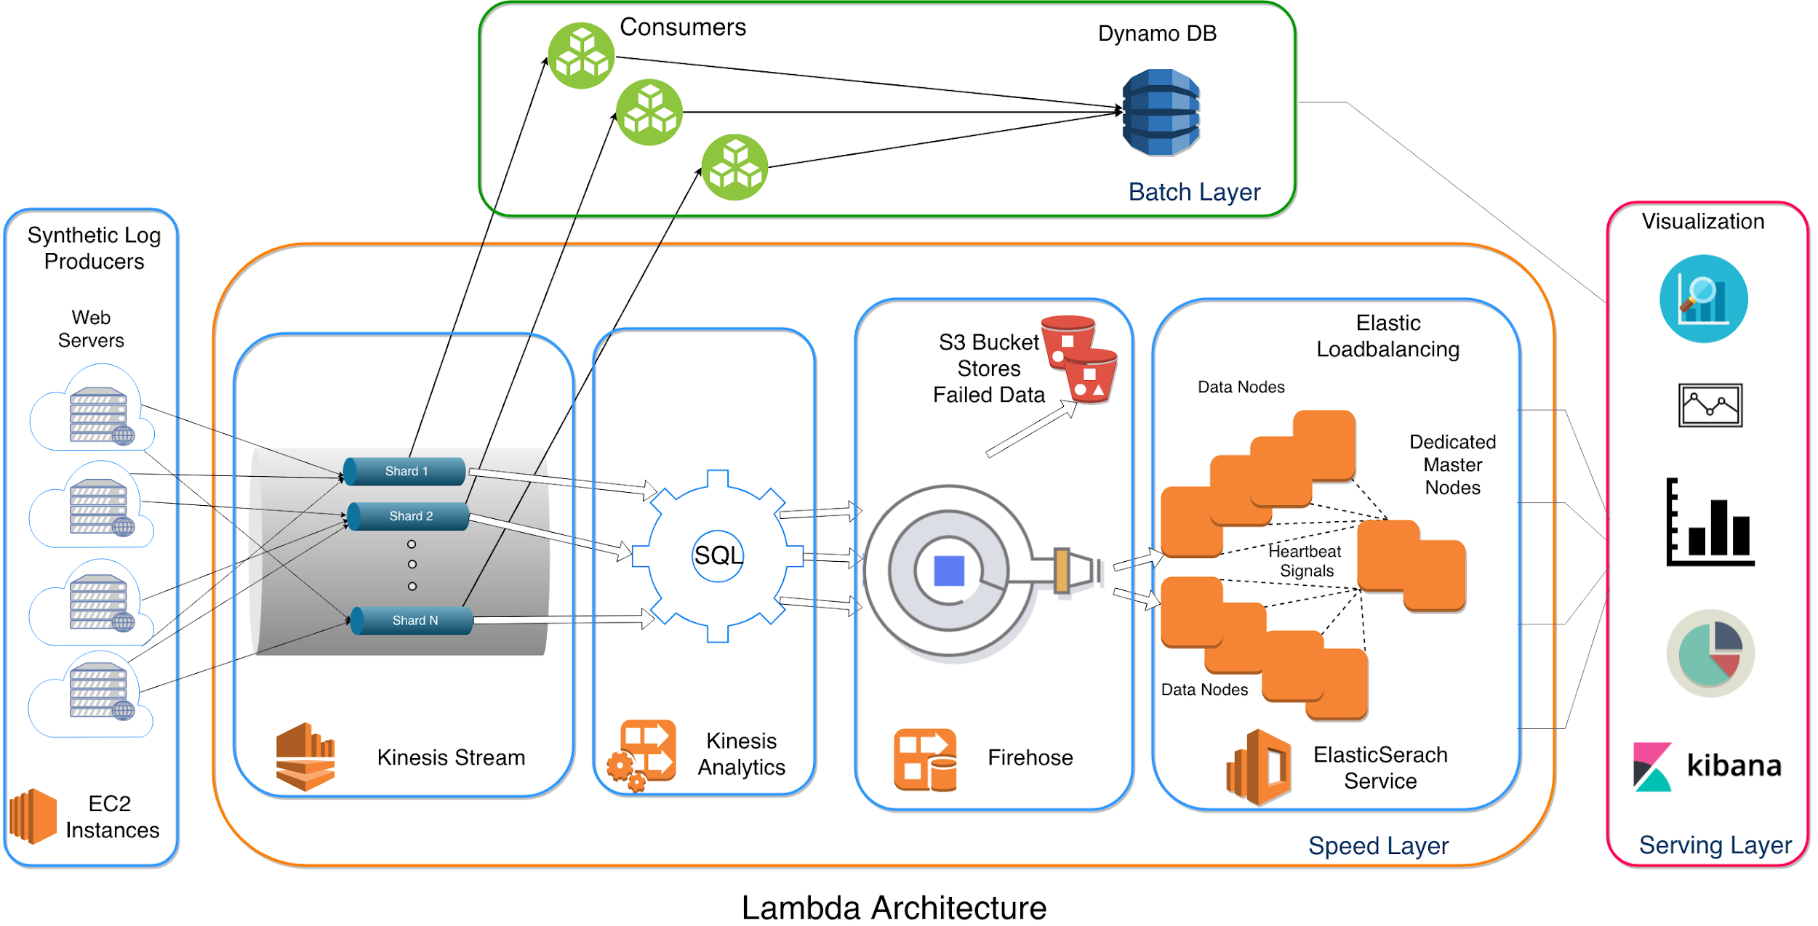
Architecture
Notes:
Architecture Diagram
Lambda
Firehose can backup your data to S3 bucket while delivering to elasticsearch (only failed records, can be configured to backup every data)

Slide 8
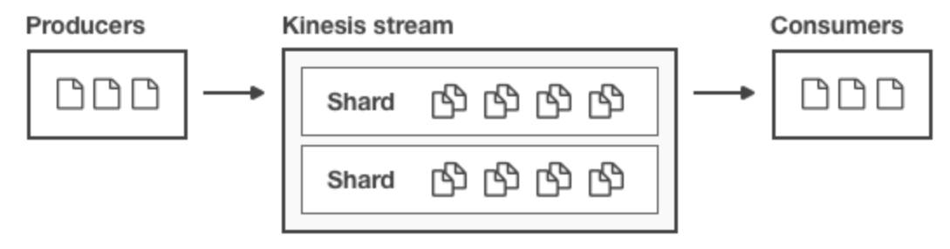
RESOURCES
Kinesis Stream
What
Why
Durable - Implicit replication ensures no data loss
Fault tolerant by Retention Policy - 24 hours
Low Latency & Low Cost
Secure (VPC)
Notes:
Streaming Application
Pub-Sub Model
Shards

Slide 9
RESOURCES
Amazon Kinesis Data Analytics
What
Analyze Streaming Data
SQL/Flink Analytics
Actionable Insights
Why
SQL - Familiar
Easy aggregations
Serverless
Notes:
What?
Analyze Streaming Data
SQL/Flink Analytics
Actionable Insights

Slide 10
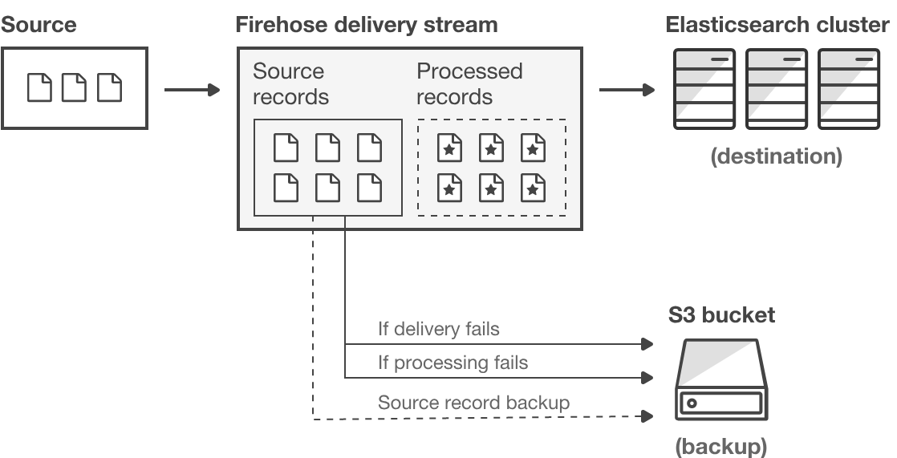
RESOURCES
Firehose Delivery Stream
What
Why
Near Real-time
Configurable buffer size (mb) and interval (seconds)
Backup Data to S3 (in our case, only failed records)
Notes:
Firehose can backup your data to S3 bucket while delivering to elasticsearch (only failed records, can be configured to backup every data)
1 MB or 50 sec

Slide 11
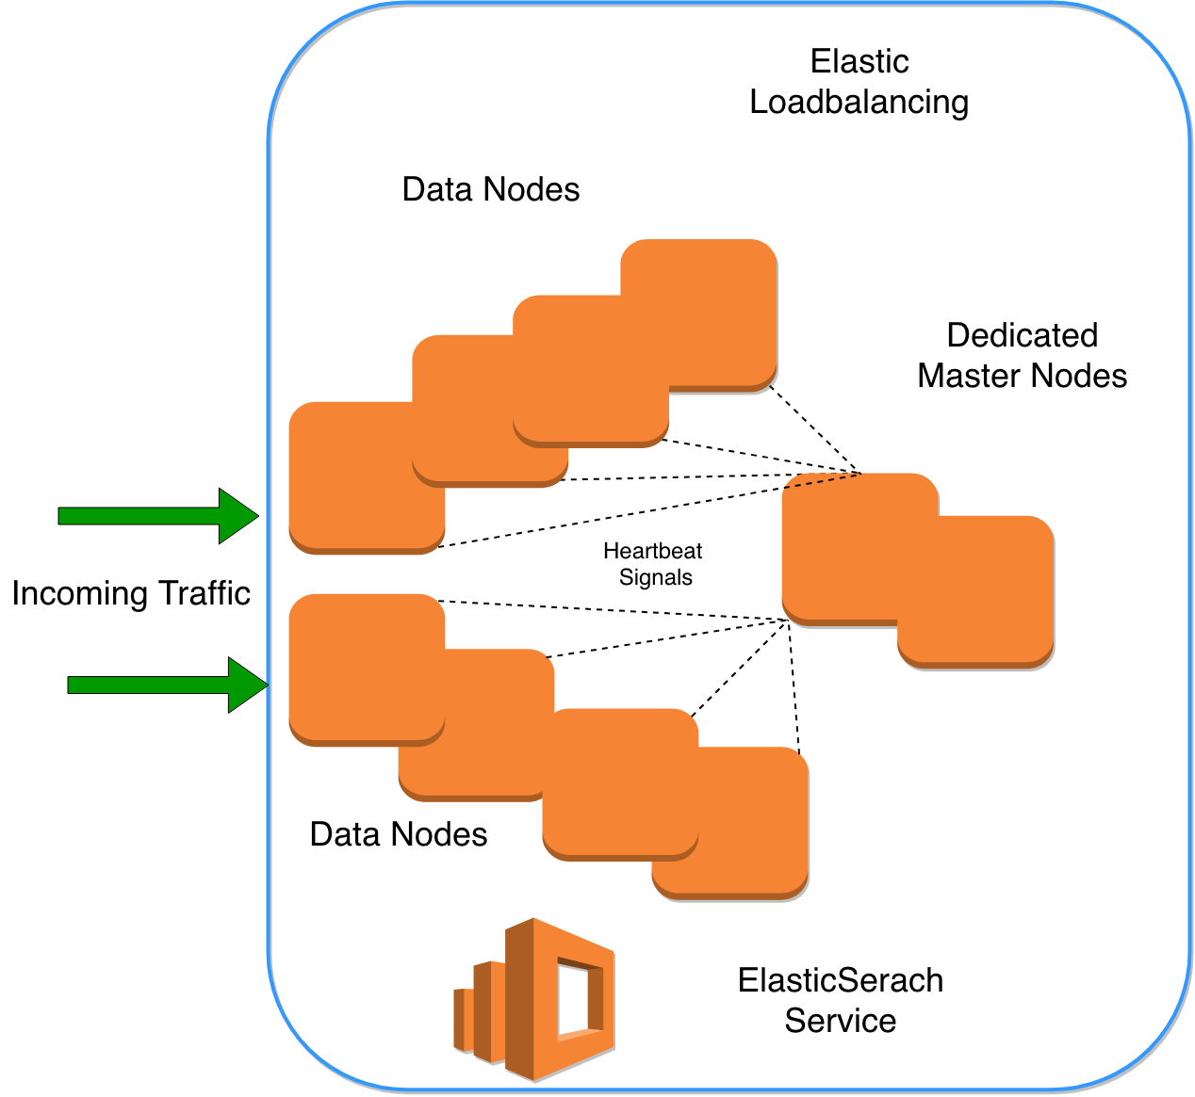
RESOURCES
ElasticSearch Service
What
Why
Efficient Indexing
Highly Available
ElasticSearch-as-a-Service
Integration with Kibana
Notes:
In an Elasticsearch cluster, we have configured distributed nodes of type Elasticsearch. The auto-scaling policy is set to scale out the traffic across nodes during high velocity of streaming log data. It also automatically detects and replaces failed Elasticsearch nodes. It has dedicated master nodes to offload cluster management tasks as seen in figure 5. It also provides automatic backup and restores Elasticsearch domains[10]. The cluster node allocation is done across two availability zones in the same region which is also called as zone awareness.

Slide 12
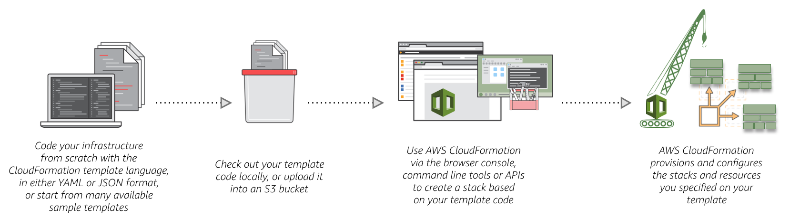
RESOURCES
Amazon CloudFormation
What
Why
Infrastructure as Code (JSON/YAML)
Automation - One-click deployment of whole infrastructure
Backups & Versioning
Notes:
Infrastructure as code

Slide 13
RESOURCES
DynamoDB
S3
CloudWatch
CloudFormation
IAM Roles
VPC
Boto3
Python3
Kibana
EC2
Kinesis Streams
Kinesis Analytics
SQL / Flink
Firehose Delivery Stream
Elastic Block Storage
Elasticsearch Domain

Slide 14
HOW?

Slide 15
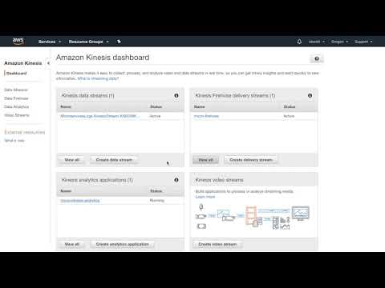
Video of Infrastructure
Notes:
IaaS
Resources

Slide 16
EXPERIMENT
Number of Web Servers (Microservices) | Process per machine | Records per process per second per machine | Total records per second
8 | 10 | 200 | 16000
Window of 3 minutes ≈ 200 seconds ≈ 3.2M records
Notes:
I would like to talk about one experiment we did.
Going from 3000 records to 3M records were very smooth and handles auto-scaling of clusters, resources.
But this was not smooth on our AWS billing (as it used our 80 % of our free tier)

Slide 17
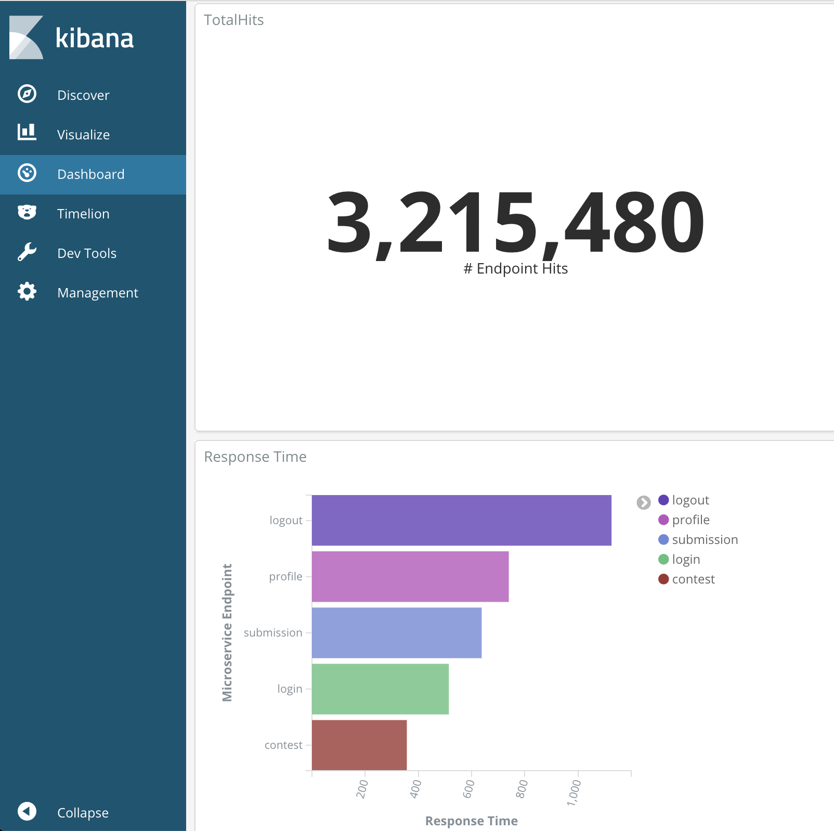
EXPERIMENT
Notes:
This is how our experiment looks like

Slide 18
VISUALIZATION
See our application in action

Slide 19
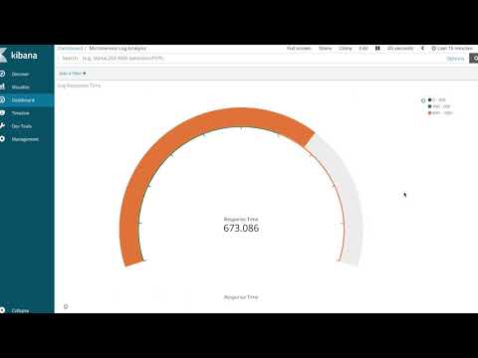
Video of Visualization
Notes:
Trend of change of the viz
dashboard

Slide 20
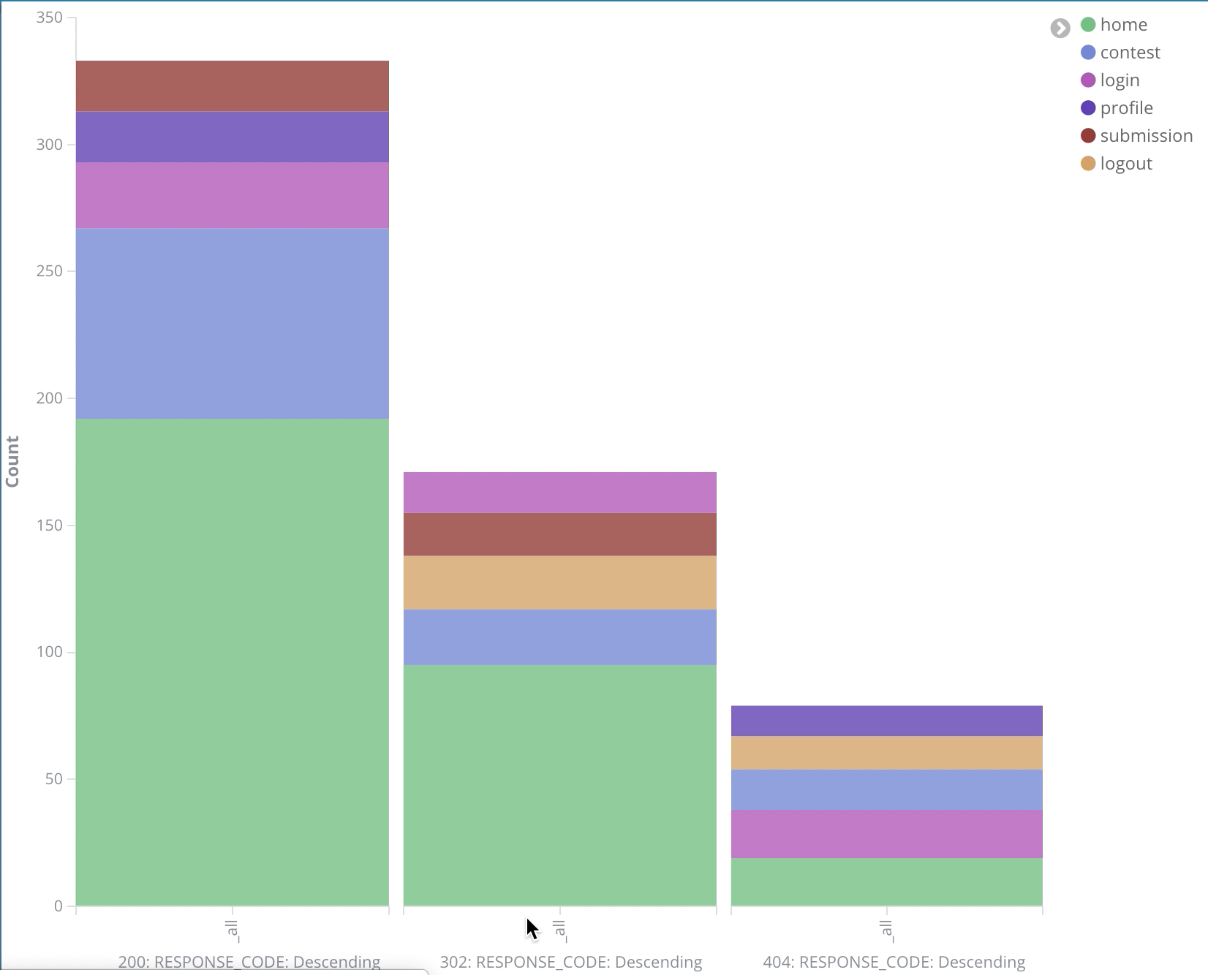
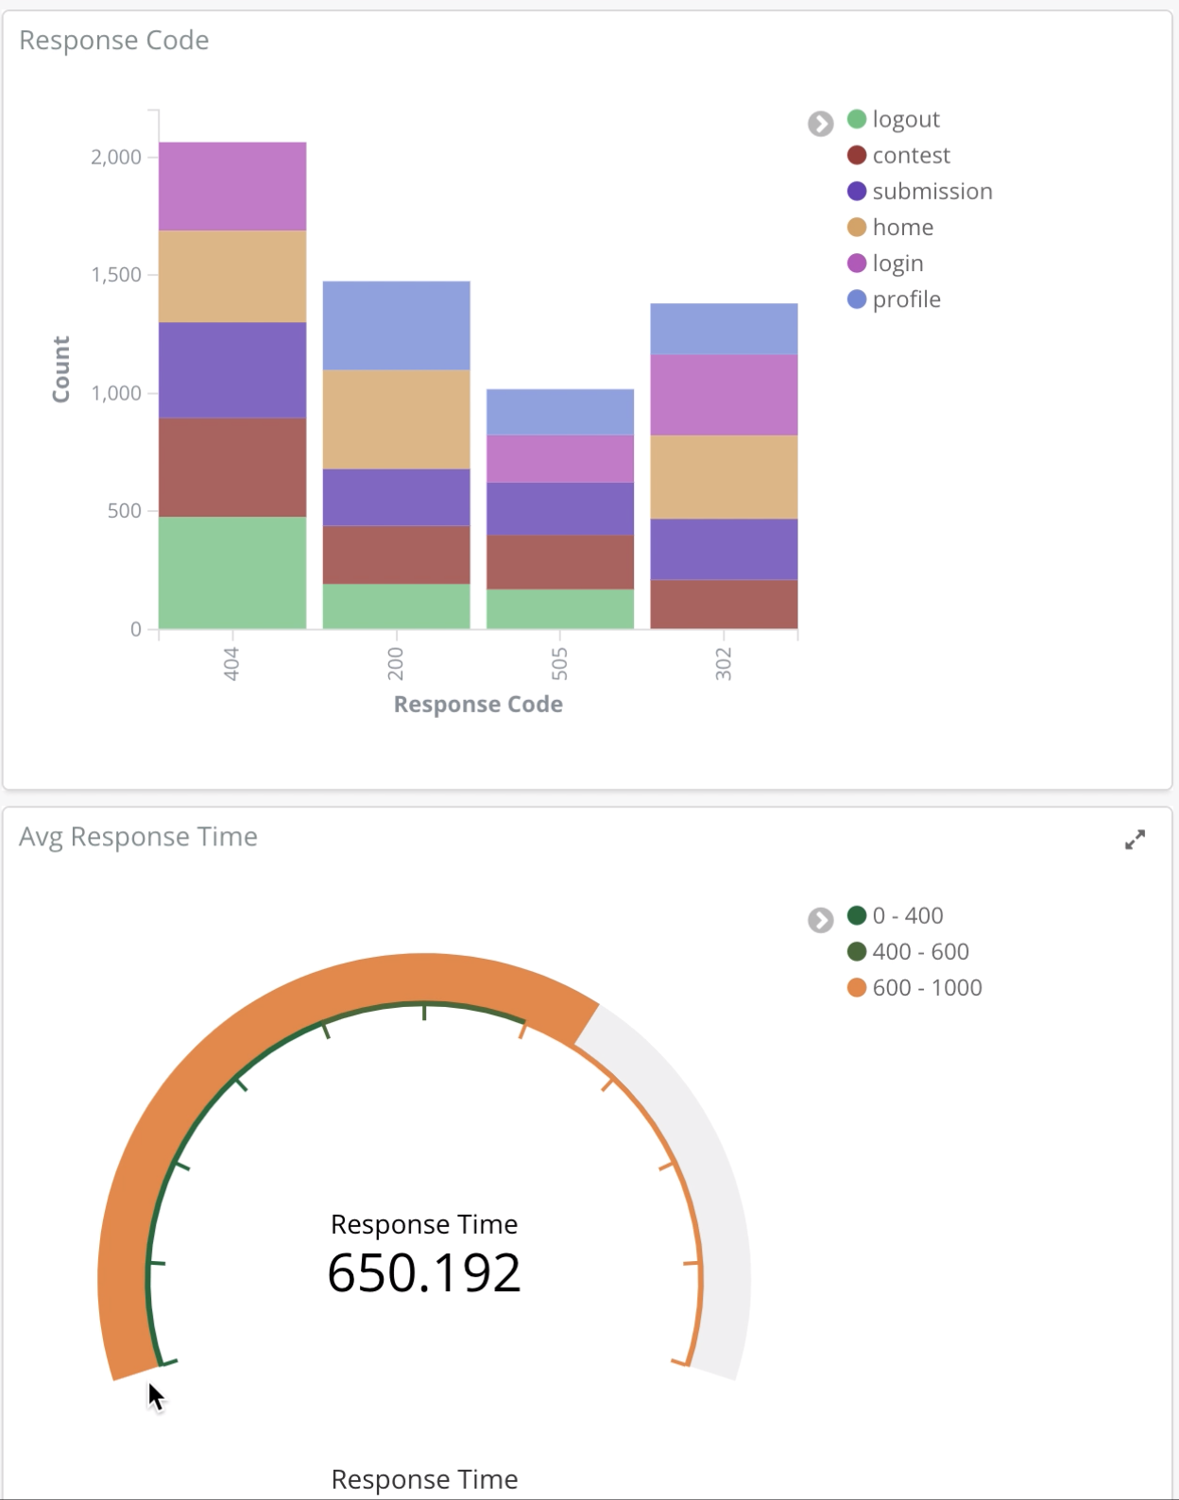
PORTABLE
VISUALIZATION
Place your screenshot here
Place your screenshot here
Place your screenshot here
Notes:
access from anywhere on any device
but as mentioned earlier you must be in the systems’ VPN

Slide 21
ANALYSIS
Pros
Configurable
Availability
Low Cost
Scalability
Deployment
Visualization
Cons
Limited flexibility (AWS Ecosystem)
Replication
Latency
Notes:
Data is replicated in DynamoDB & ElasticSearch Domain
Latency bcz of firehose

Slide 22
LEARNING
OUTCOMES
Simulating high velocity data ingestion
Synthetic Generators
Analysing Streaming Data
SQL vs Flink
Optimal configuration for saving cost
Knowledge of use and limits
Cloud Resource Management & Provisioning
AWS CloudFormation
Notes:
Aggregation was simple and setting up Flink was project in itself

Slide 23
BUSINESS VALUE
What are we providing to customers?
Easily plugable system
Auto-Scaling Architecture
Availability across zones
Tailored solutions with AWS Cloud
Security using VPC and Subnet

Slide 24
THANK YOU

